Slide 1
Higher Biology
Differentiation in Multicellular Organisms
Mr G R Davidson

Slide 2
Differentiation
In the very early stages of life all cells are identical and unspecialised.
Differentiation soon happens and these unspecialised cells become specialised.
This means they are altered and changed to perform a specific function.
At this point they become part of a tissue.

Slide 3
Differentiation
Differentiation happens when:
Some genes are switched off.
Genes for specific functions are switched on.
Genes vital for life are expressed, e.g. genes which code for enzymes which control the metabolic reactions.

Slide 4
Meristems
In plants, growth occurs in areas called meristems.
These are areas of unspecialised cells which can divide repeatedly.
These cells will eventually become specialised as they get further from the meristem.

Slide 5
Apical Meristems
Apical meristems are found at the apex of the plant, i.e. the root tip and the shoot tip.
This is where new cells are produced which results in the plant increasing in length.

Slide 6
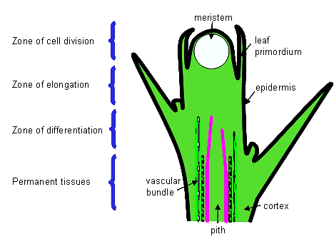
Apical Meristems
Shoot

Slide 7
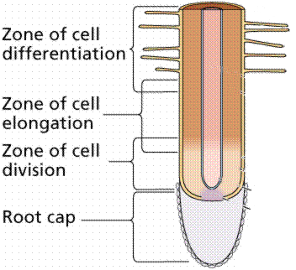
Apical Meristems
Root

Slide 8
Lateral Meristems
As plants get bigger, they need more and more support.
They do this by increasing in thickness which involves producing new tissues in their lateral meristems.
These lateral meristems are called cambium.

Slide 9
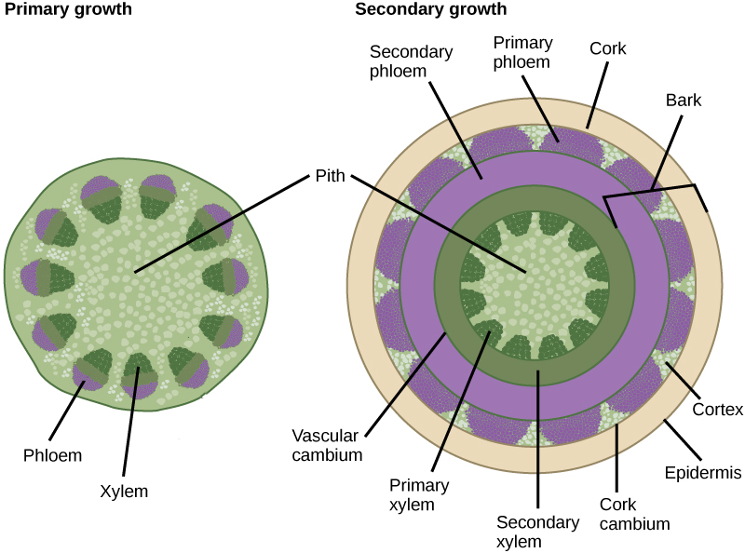
Lateral Meristems

Slide 10
Stem Cells
Animal cells also undergo differentiation.
The zygote divides repeatedly to create an embryo.
The cells of the embryo, at this stage, are undifferentiated and are called stem cells.
Stem cells can be found all over the body and can differentiate into specialised cells typical of their location.

Slide 11
Stem Cells
Embryonic stem cells can differentiate into all types of specialised cell.
A ball of embryonic stem cells is called a blastocyst.
All the cells in a blastocyst have genes which can be switched on to create any kind of specialised cell.

Slide 12
Stem Cells
Adult stem cells have a narrower range of capabilities than embryonic stem cells.
They are only found in specific locations in the body.
They only replace specialised cells which have a limited life span because many of their genes are switched off.

Slide 13
Stem Cell Research
Stem cells from mice and humans have been cultured to investigate gene expression.
When they are grown in the presence of growth factors, they continue to divide and produce more stem cells.

Slide 14
Stem Cell Research
When the growth factors are absent, the stem cells quickly begin to differentiate.
By studying why this is, scientists hope to gain a clearer understanding of gene expression.

Slide 15
Stem Cell Research
Stem cells which can divide and produce all types of specialised cell are called pluripotent.
Stems cells which can only divide to produce a few types of specialised cell are called multipotent.

Slide 16
Stem Cell Sources
Pluripotent stem cells originate from excess embryos donated by couples undergoing IVF treatment.
The embryos are taken to an aseptic lab and put in a growth medium at 37ºC for 8 days.

Slide 17
Stem Cell Sources
This takes them to the blastocyst stage.
The inner mass of the blastocyst is then removed and the cells can be used for either research, or for replacing damaged tissue.

Slide 18
Therapeutic Value of Stem Cells
Stem cells can be used in a number of procedures to replace damaged or diseased tissues, e.g.
Skin grafts
If a person loses a lot of skin or is badly burnt, stem cells can be removed from that person and cultured to produce new skin.
This new skin can then be grafted over the damaged area.

Slide 19
Therapeutic Value of Stem Cells
Cornea Repair
There are stem cells on the edge of the cornea which can be removed from a person’s good eye.
These cells are transferred to the damaged eye and in most cases the patient’s sight is restored.

Slide 20
Therapeutic Value of Stem Cells
Bone Marrow Transplant
Bone marrow stem cells are used to treat the likes of leukaemia and sickle cell anaemia.
The patient’s own bone marrow cells are destroyed and replaced with healthy stem cells which will produce new bone marrow.

Slide 21
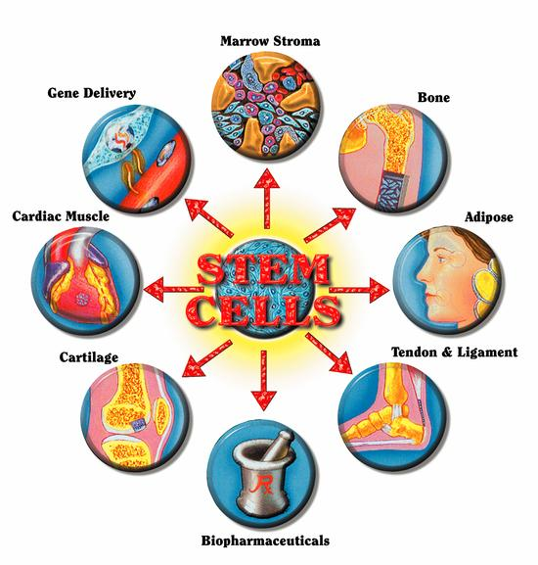
Therapeutic Value of Stem Cells

Slide 22
Stem Cell Ethical Issues
There are a number of ethical issues concerning the use of stem cells.
Unused embryonic stem cells have to be destroyed after 14 days and in some people’s opinion, this is unethical.
Stem cells may cause other conditions or diseases, and so they need to be safe.

Slide 23
Stem Cells Ethical Issues
The use of stem cells needs to be very carefully controlled and regulated.
This ensures that the procedures are safe and that there is no abuse of the procedure.
It also ensures the stem cells are of the highest quality.

